Slide 1
HPC
OpenMP Lab 2
Eng. Malak Madkour

Slide 2
Outlines
OpenMP Basics
Environment Setup
Problem

Slide 3
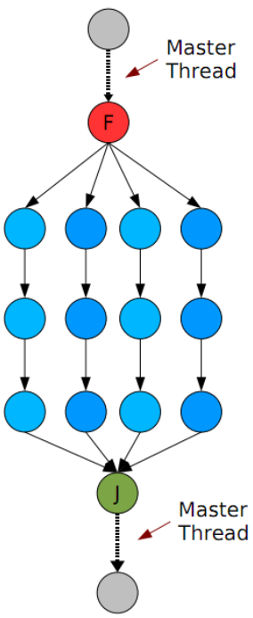
OpenMP Execution Model
Any parallel program may have its execution expressed as a directed acyclic graph.
A fork is when a single thread is divided to multiple, concurrently executing threads.
A join is when concurrently executing threads gets reduced into a single thread.

Slide 4
OpenMP Execution Model -Cont
All OpenMP programs begin as a single process: the master thread.
The master thread executes sequentially until the first parallel region construct is encountered.
The statements in the program that are enclosed by the parallel region construct are then executed in parallel among the various team threads.
Each thread runs on its own processor, though it is becoming common for each CPU or “core” to handle more than one thread “concurrently”; this is called “hyperthreading”
During the overall execution, threads may communicate with one another through shared variables

Slide 5
OpenMP Limitations
the more shared variables (address spaces) one has among the threads, the harder the SMP must work to ensure that their view of the variables are current – this is called cache coherency.
at some point, the overhead associated with ensuring cache coherency (consistency) will cause the parallelization to stop scaling with more processors.

Slide 6
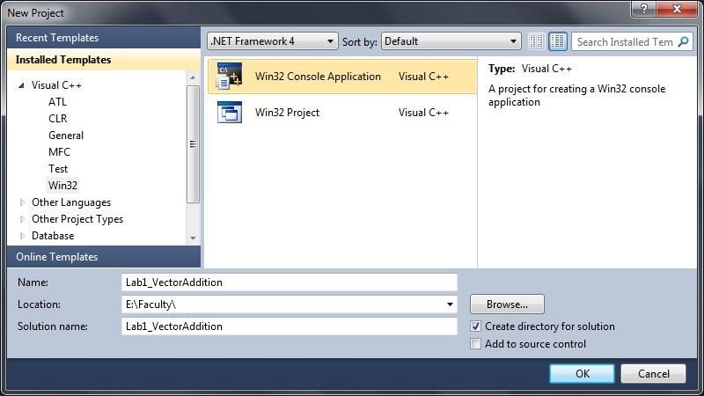
OpenMP Environment Setup
Open Visual Studio and open New menu
Select Project menu
The project type and settings should look like the settings defined in Figure 1
Figure 1

Slide 7
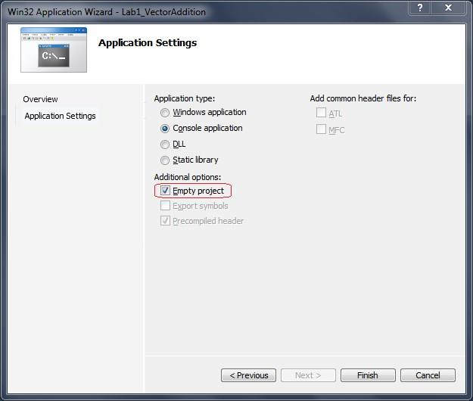
OpenMP Environment Setup -Cont
Make sure to select Win32 Console Application as the project type
When the new application wizard opens make sure to make the project empty check Figure 2
Figure 2

Slide 8
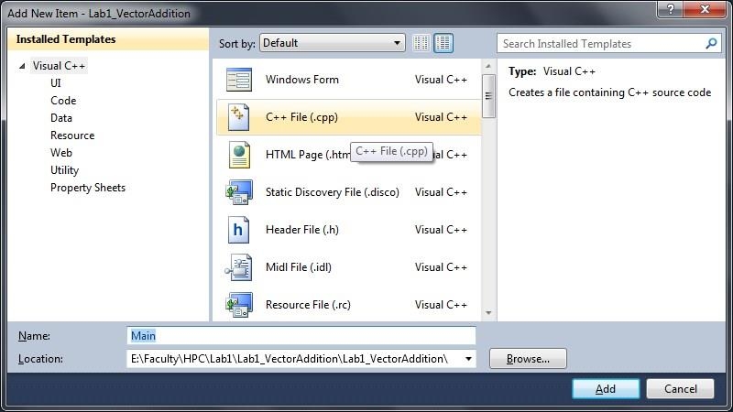
OpenMP Environment Setup -Cont
Once the project is created open the solution explorer panel. If the panel is hidden you can show it by accessing the following menu View->Solution Explorer or just press Ctrl + Alt + L
Expand the project tree in Solution Explorer. Then right click on the Source Files node
Choose Add->New Item
Name the file main and make sure the file type is C++ File (.cpp) check Figure 3
Figure 3

Slide 9
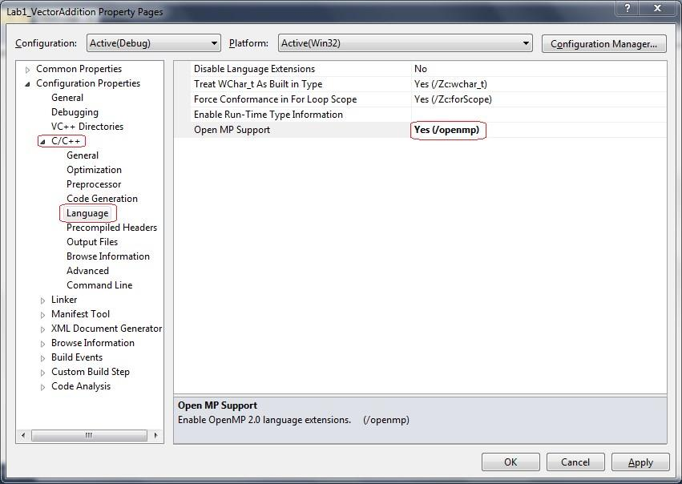
OpenMP Environment Setup -Cont
The final step is to enable OpenMP in your project. To-do so follow the following steps. a. In Solution Explorer right click on the project node and choose Properties. b. Then expand C/C++ node and choose Language node. c. In the right side make sure to enable OpenMP. Check Figure 4
Figure 4

Slide 10
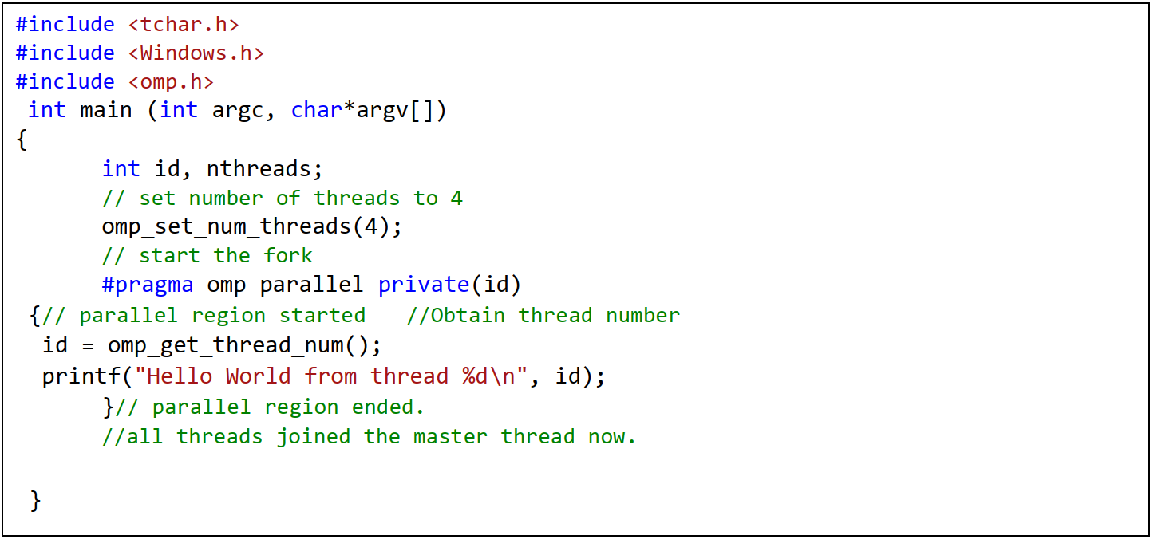
Writing Your First OpenMP Program

Slide 11

Writing Your First OpenMP Program

Slide 12
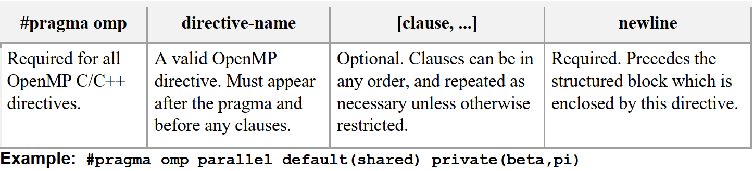
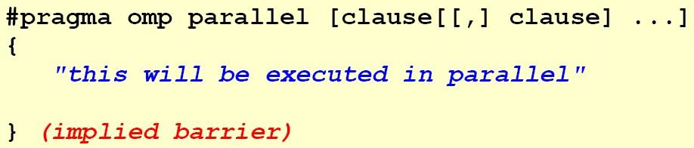
OpenMP Directives
A parallel region is a block of code executed by multiple threads simultaneously

Slide 13
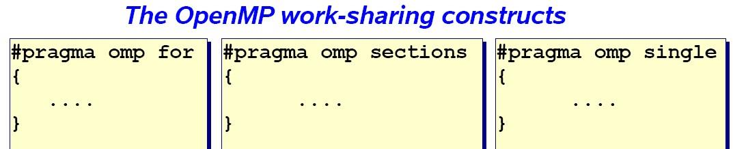
The work is distributed over the threads
Must be enclosed in a parallel region
Must be encountered by all threads in the team, or none at all

Slide 14
Vector Addition
Two vectors of the same length can be added by adding their corresponding elements Ci = ai +bi, where 1<= i <=n /************************************************************** FILE: omp_workshare1.c * DESCRIPTION: * OpenMP Example Vector addition * In this example, the iterations of a loop are divided into equal chunks according * to the vector length and number of threads. * Each thread will perform a CHUNK of iterations at a time * Note the vector length is divisible by the number of threads ************************************************************/

Slide 15
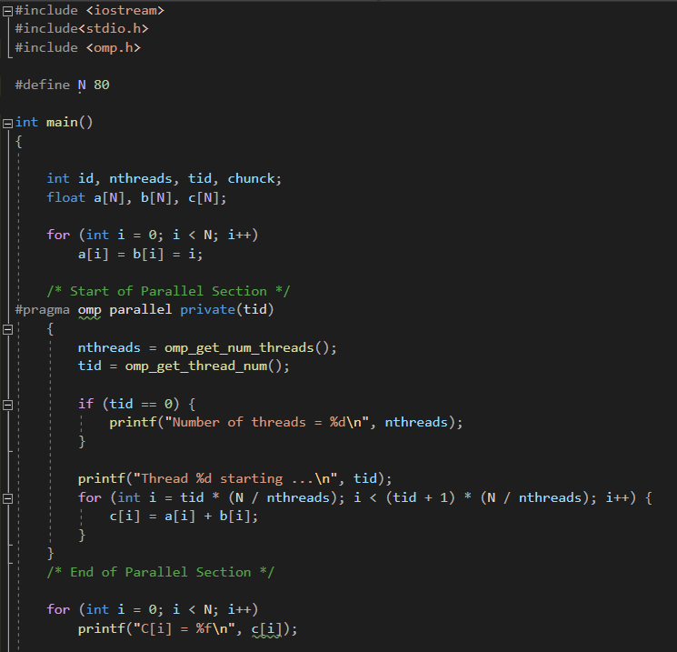
Solution

Slide 16
Hands-on 1
Array Search
❖Cover page (includes name, ID, course name and number, University logo, and submission date)
❖Lab problem statement
❖Introduction to Solution
❖Flow chart
❖Code with comments
❖Screenshot of output
❖Submit on LMS “Hands-on 1 Lab 2”

Slide 17
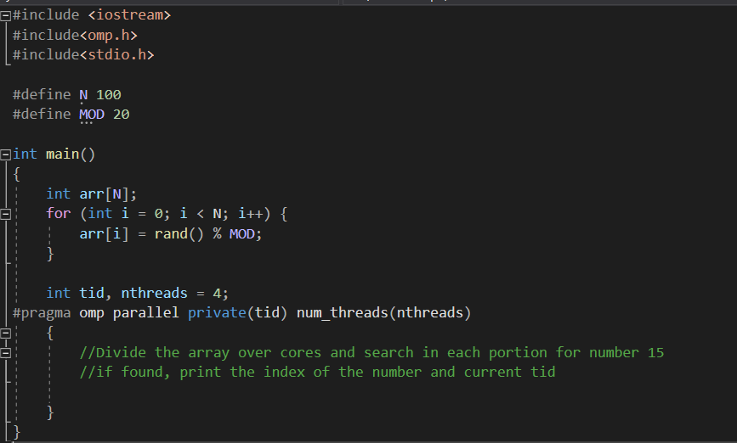
Hands-on
Given an array with size N=100, search in the array for a specific number (15) and print ALL indices in which this number appears, and the id of the thread in which this number was found.

Slide 18
Thank you

